Slide 1
Penn Graduate Consulting Club
(PGCC)
[August 17th Student Panel]

Slide 2
Our focus
Increasing awareness of alternative career paths by introducing the Penn graduate and post-doctoral community to career opportunities in management consulting
Equipping non-MBA students with basic business knowledge
Providing opportunities to practice for case interviews
Helping consulting firms facilitate the recruitment of non-MBA graduate students at Penn

Slide 3
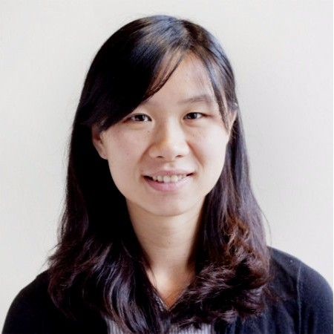
Kickoff Event
September 3rd, 6-7pm
Keynote Speaker: Caiyue Xu
  Former co-president of PGCC
  Cell and Molecular Biology PhD graduate, Berger lab
  Current life science specialist at L.E.K
Register at the link on our Instagram @upenn_pgcc

